Slide 1
SHOP
Creating E-commerce Cart System in PHP Project Proposal
Jessie Lan Course: MASY1-GC-3540 Database Technologies for Web Applications Professor Joseph Ng April 27, 2020

Slide 2
Agenda
PAY
01
Introduction
Database Design
02
03
Web Application Design
04
Technical Design
05
Link to your Implemented Solution
06
Testing
Notes:
Outline of Business Benefits

Slide 3
Project Summary
Client
Admins
People from anywhere can buy products online.
admin can monitor the activity of the users and checks the online transactions.
Notes:
People from anywhere can buy products online. And admin can monitor the activity of the users and checks the online transactions in database

Slide 4
Shopping Cart Features
A
B
C
D
retrieve product information /create product gallery
log in/log out/registration/reset password
Admins can update/change/delete shopping items in database
manage cart items/
submit orders

Slide 5
Technology and Tools
Front End
Back End
Software
HTML, CSS, Java Script
MySQL, PHP
XAMPP, PHPStorm
SERVICES

Slide 6
Outline of Business Benefits by using PHP Sessions
Easy to Use
Cost Efficient
Flexbile
Integrative
Less time-consuming
Secured
Convenient
Attract more customers and boost its sales

Slide 7
Database Design
MySQL
Database
Name: Store
This table stores information for item id, item name, price and image.
Items Table
XAMPP Server
Users Table
This table stores user information of user id, username, user email, password, contact, city, and address.
PHP
Users_items table
This table is to store status of items in the user’s shopping cart. It contains id, user id, item id, status.
Notes:
http://localhost/phpmyadmin/index.php?route=/database/structure&server=1&db=store
MySQL: MySql is a database, widely used for accessing querying, updating, and managing data in databases.
PHP: PHP is open source software that allows software developers to create dynamically generated web pages, in HTML, XML,or other document types, as per client request.

Slide 8
Web Application Design
Welcome Page
Products Page
Cart Page
Notes:
HTML: HTML is used to create and save web document
CSS : (Cascading Style Sheets) Create attractive Layout
JavaScript: it is a programming language commonly use with web browsers.

Slide 9
Technical Design
Registration form
A
Log in Form
Log out Form
B
E-COMMERCE Account
Settings Form
C

Slide 10
Link to your Implemented Solution
All files can be founded here: http://oit2.sps.nyu.edu/~jl11190/store.zip
Download and unzip this file into your localhost. (C:\xampp\htdocs\store) or any web server.
Then use XAMPP to connect with your MySQL database.
Create “store” database, tables in MySQL and import store.sql file in the database folder.
Set up PHP connection to connect your host with MySQL database.

Slide 11
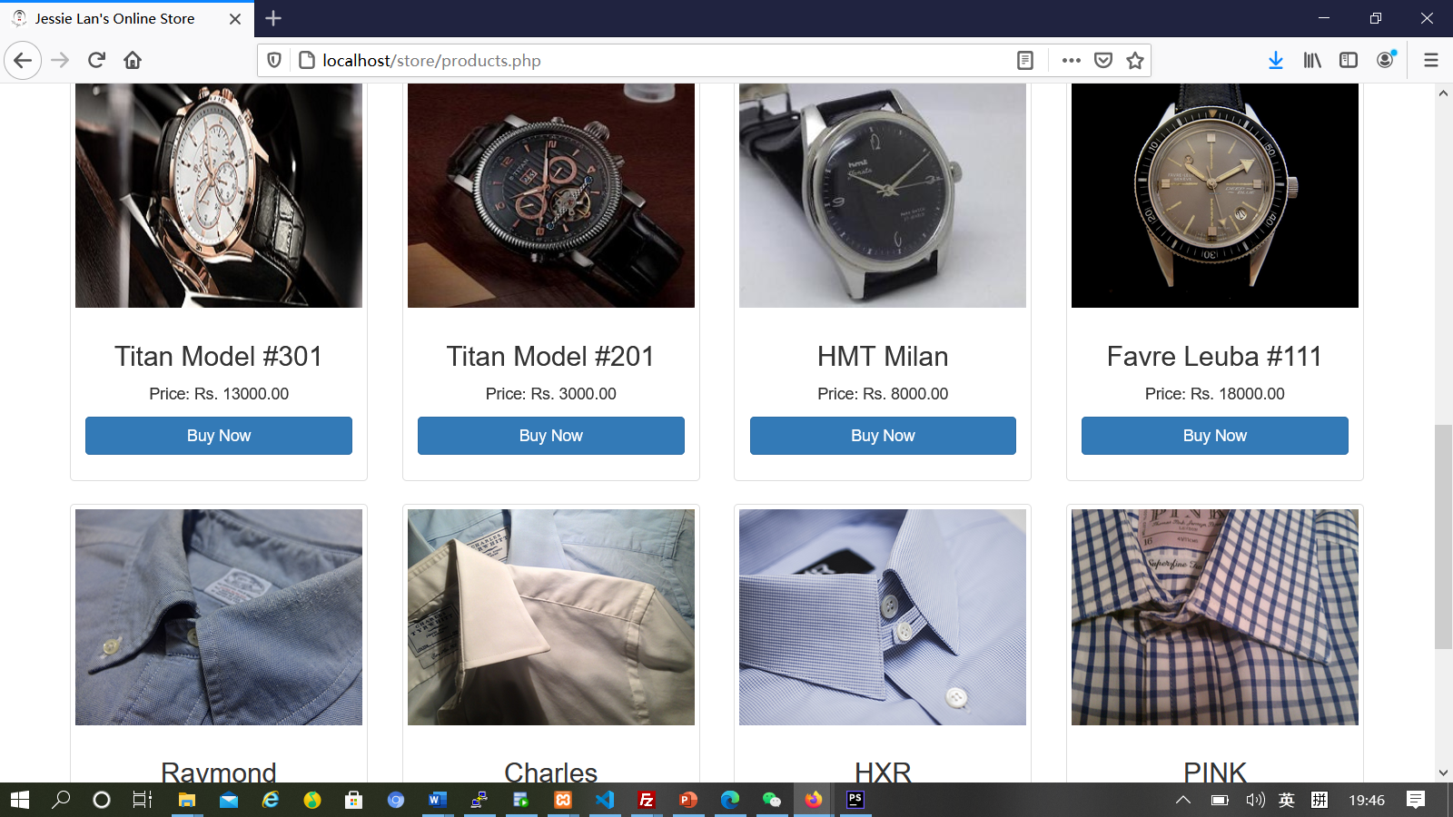
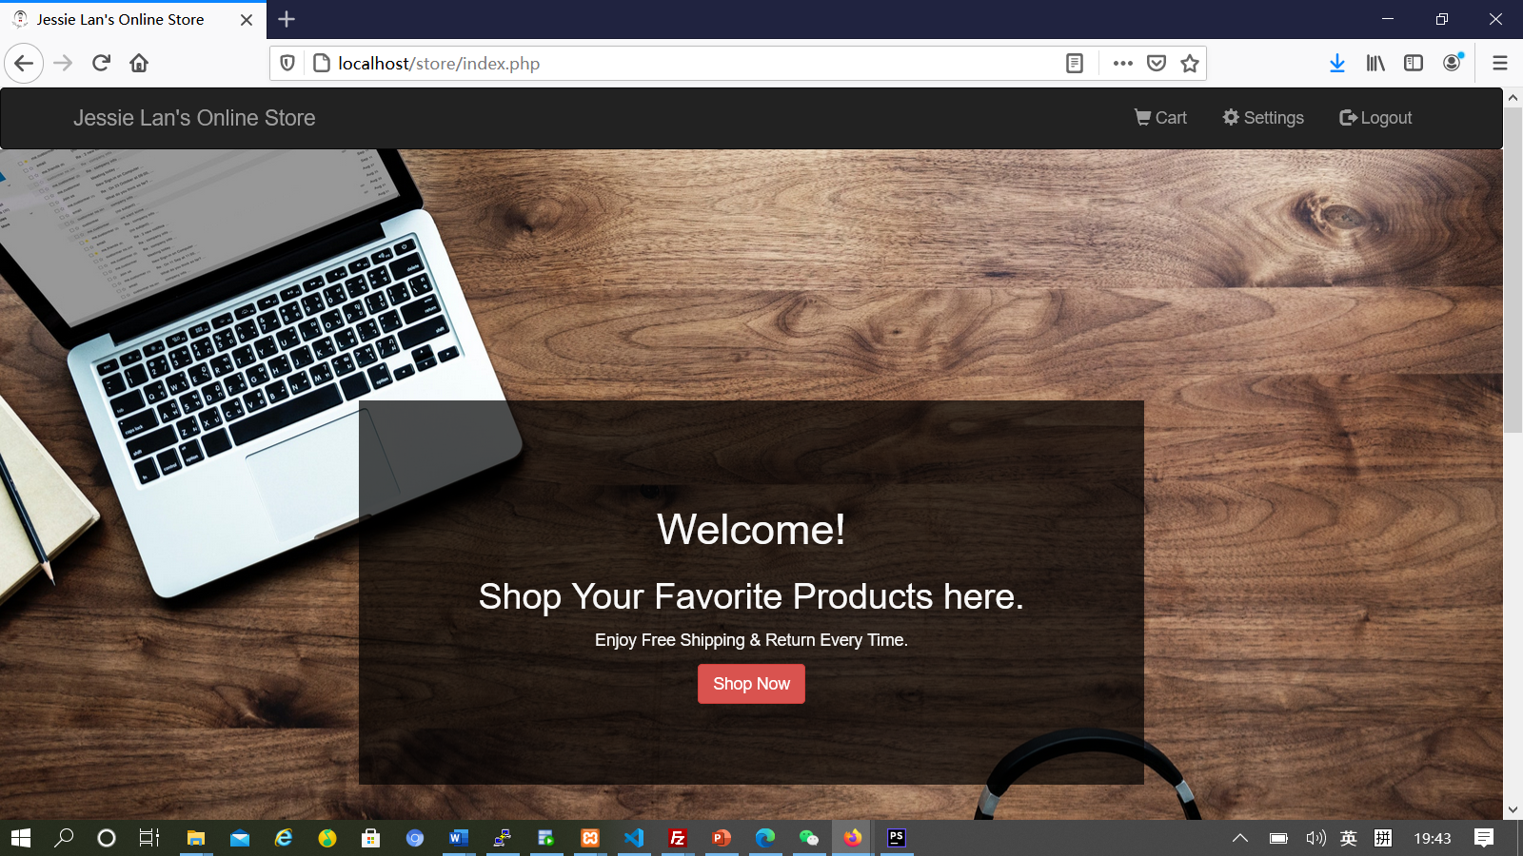
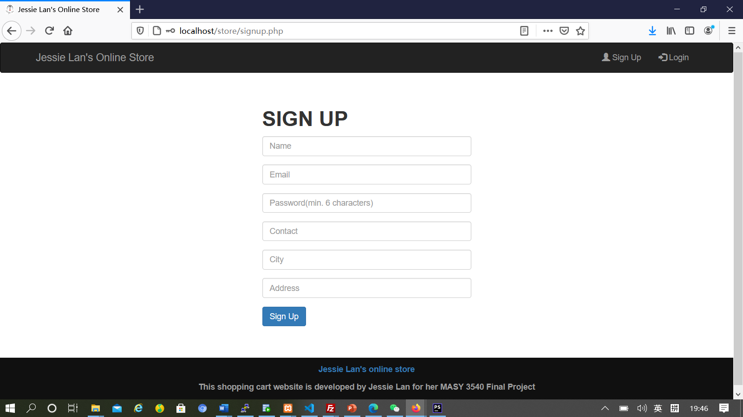
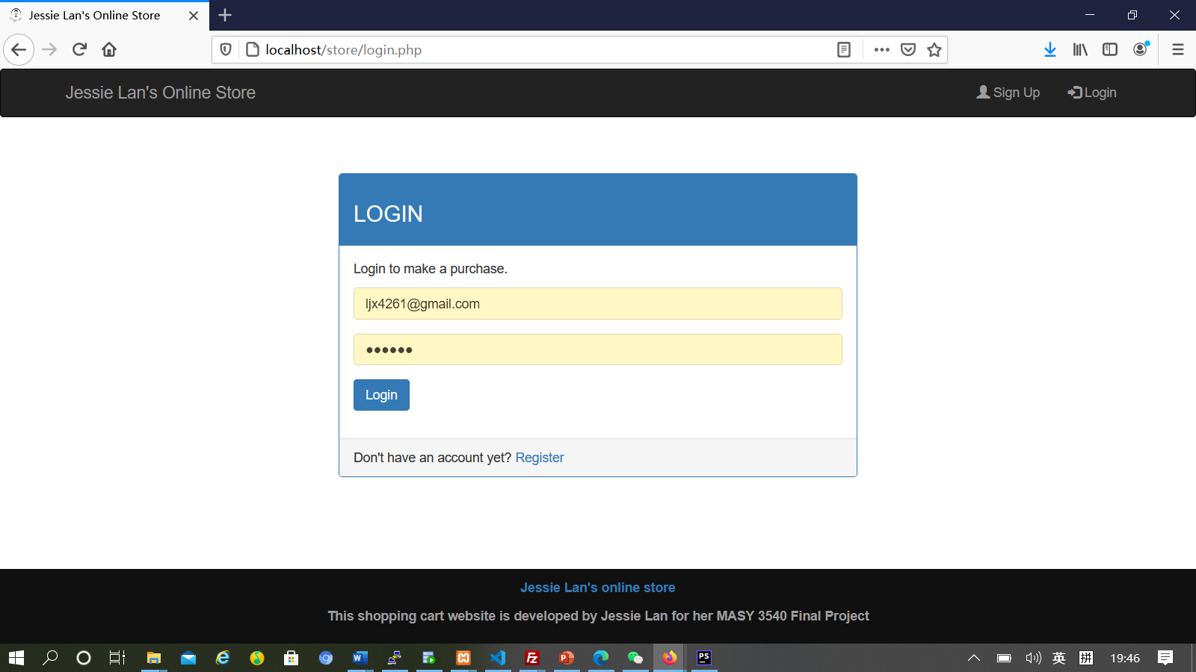
Testing

Slide 12
Thank You
A
B
C

